Slide 1


February 2026
A Statistical and Temporal Analysis of Gacha Mechanics in Wuthering Waves Using Featured Resonator Convene Records: An Exploratory Single-Account Analysis
Presented By: Carpio, Lee-an Mar Anicken P.

Slide 2

Study Overview
Research Objectives and Significance Explained
This exploratory study aims to analyze gacha mechanics by examining a single account's detailed pull records, offering empirical insights into player behavior and game dynamics.

Slide 3
Dataset Overview
Insights into the research dataset characteristics
The study analyzes a total of 582 pulls over 97 days, focusing exclusively on the Featured Resonator banner and capturing distinct pull behaviors across 24 active days.

Slide 4
Research Methods
Analyzing Gacha Mechanics Through Data
This study employs a comprehensive analytic approach involving data cleaning, feature extraction, exploratory data analysis, and statistical inference to thoroughly assess gacha mechanics.

Slide 5
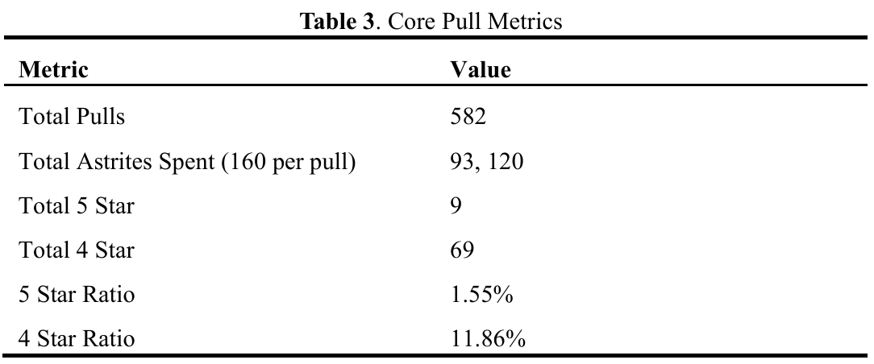
Core Metrics
Key Statistics of the Dataset
This dataset consists of 582 total pulls, with 93,120 Astrites spent and 9 five-star pulls obtained, providing ample data for preliminary analysis of gacha mechanics.

Slide 6
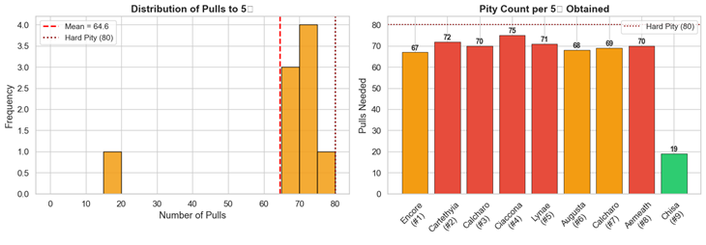
5-Star Pull Statistics
Analysis of 5-Star Pull Patterns
The dataset reveals a mean pity of 64.56 pulls for 5-star drops, with a range of 19 to 75 pulls, indicating consistent mechanics without hard-pity breaches.

Slide 7
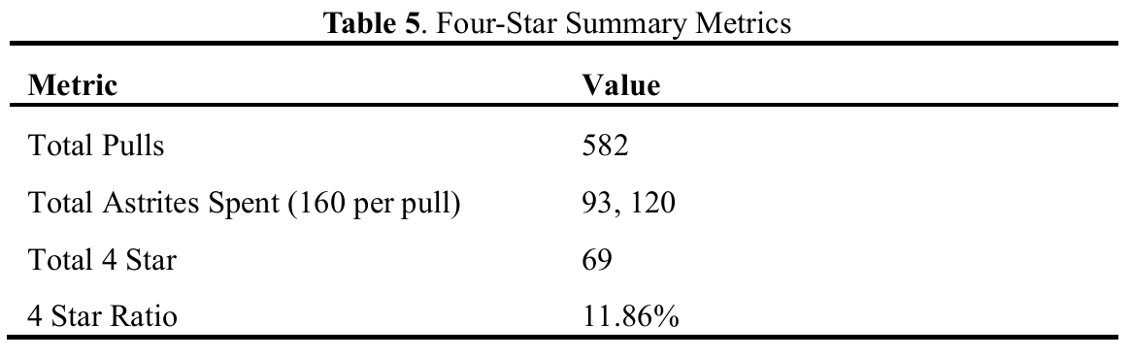
4-Star Pulls
Overview of 4-Star Pull Statistics
A total of 69 four-star pulls were recorded, yielding a 4-star pull ratio of 11.86%. Most four-star outcomes occurred within the expected range of 7.42 pulls.

Slide 8
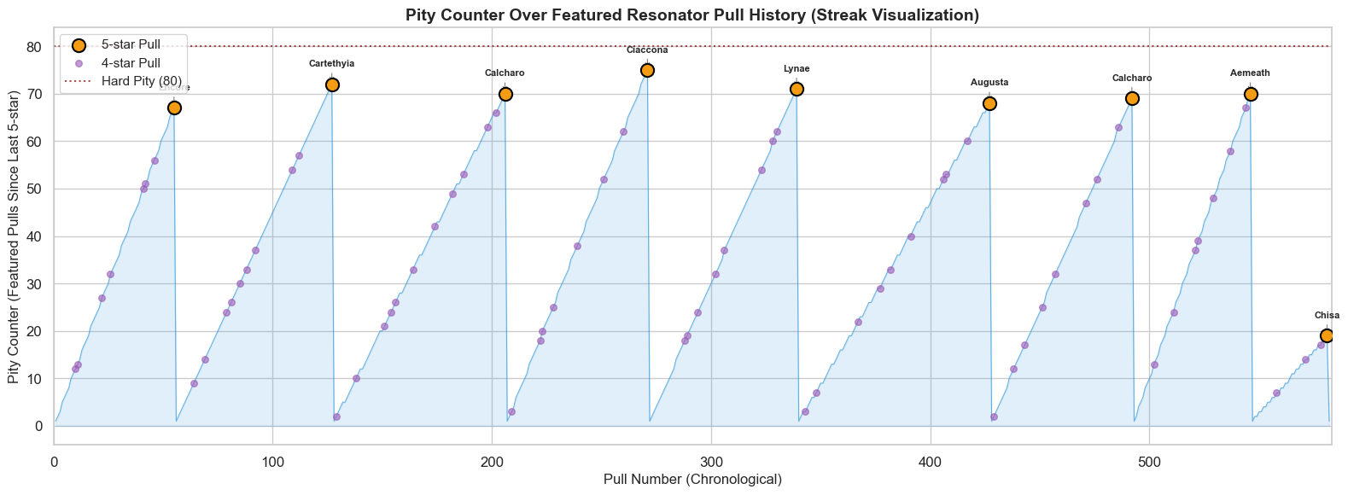
Pull Patterns
Analyzing Temporal Trends and Streaks
This section explores the timing of pulls and associated streak behaviors, revealing how player habits and pity mechanics influence overall gacha outcomes and success rates.

Slide 9
Hypothesis Testing
Statistical test results and interpretations
The analysis revealed a borderline significance with a p-value of 0.0566, indicating potential effects while cautioning against overinterpretation due to a limited sample size.

Slide 10
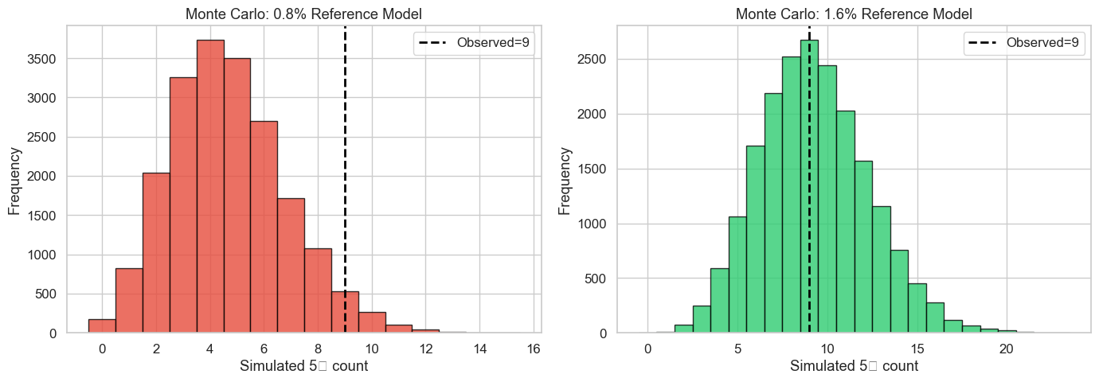
Monte Carlo Simulations
Validating findings through statistical modeling
Monte Carlo simulations were employed to model pull distributions, confirming stability in results. Robustness checks demonstrate consistent outcomes across various assumptions, validating the analytical approach taken.

Slide 11
Findings Overview
Insights into Gacha Mechanics Behavior
The late-cycle clustering observed indicates that pity mechanics significantly influence player pull outcomes, suggesting strategic implications for both developers and players in understanding gacha systems.

Slide 12
Limitations
Exploring study constraints and caveats
This research is limited by its single-account dataset, low frequency of rare events, and reliance on model assumptions, potentially affecting generalizability and inference strength.

Slide 13
Future Research
Expanding the Study of Gacha Mechanics
Gathering multi-account datasets and incorporating qualitative player behavior insights will enhance the robustness and applicability of findings across diverse gaming environments.

Slide 14
Conclusion
Key insights and implications of research
This study highlights the structured pity effects in gacha mechanics, enhancing understanding for both academic inquiry and player experiences while emphasizing statistical methods' importance in gaming analytics.

Slide 15

Thank You

